Slide 1
Single Slide Presentation (SSP) GUIDELINES
Business Applications

Slide 2
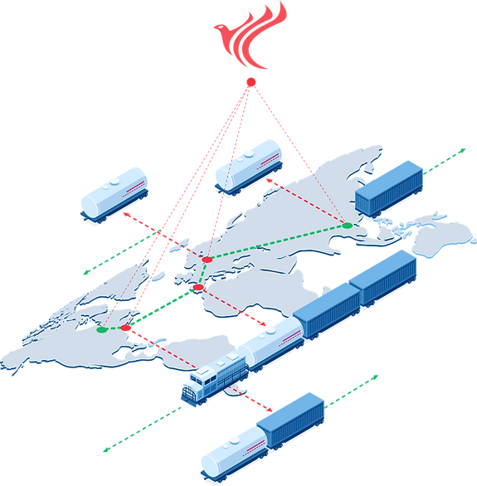
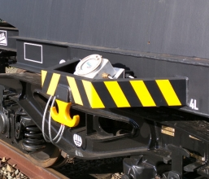
SaMoLooP
Satellite Monitoring for Logistics Safety is a comprehensive platform for real-time tracking of rail freight, and monitoring of the cargo and rail tank cars. This allows for more efficient logistics and contribute to a safer and more efficient rail freight.
https://youtu.be/NV56GVr7n0k
Satellite connectivity and GNSS services guarantee continuous monitoring in areas not covered by terrestrial connectivity
Targeted Users: Chemical companies, rail freight operators, rail network operators
Pilot test partners: Evonik, Ineos, Sabic

Slide 3
Slide Titles: Arial, White, and Capitalised (but never Bold)
All font is white text + Arial (not Verdana) – Slide Titles are size 30, text font between 25-18
Make Heading size larger…
…than Body text size: 25pt + 20 pt is a good ratio
Use this orange (H1) or this green (H2) to highlight headings or important words - do not use red
Use Bold or Italics or Underline for emphasis, but never together
Bullet points are dots, not squares or arrows
The rules regarding style are the same as for JCB papers (British English, satcom not in allcaps, spell out acronyms i.e.“Member States” not “MS” etc.. please refer to checklist)
Text: keep it short – remove as many words as possible to still make sense

Slide 4
Where To Find the Right Font Colours
If the orange and green font colours are not displaying here…
… then pick up the colour from another presentation using Eyedropper tool

Slide 5
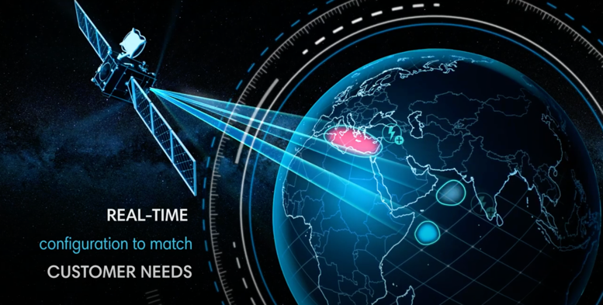
Slide Examples: with Image and Orange Highlights
Realtime shaping and steering of beams anywhere on the visible Earth
Beam hopping to allocate traffic to beams in a fully flexible way
Re-configurability and flexibility of Quantum payload accessible to end user
Note: do not use images without the correct usage rights
(courtesy/ copyright + provenance)

Slide 6
Additional instructions (I)
Please use the following logos for each activity depending on the focus:
Space for Social Value
Space for Green Value
Space for Commercial Activities
Commercialization in Space

Slide 7
Additional instructions (II)
Highlight SEI results if available, e.g. revenues, jobs, customers acquired, societal/environmental benefits
It is the intention that this should be updated in due time when new results are available
Highlight value of connectivity networks when possible
No architecture diagrams, but visuals and pictograms
No full sentences, but short messages
No more than 3-4 short messages per slide
Include logos of prime and subcos, including in the note the countries they belong to and the budget breakdown

