Slide 1


Project Title
Brief description of project here, mention the space assets used
Short project overview of no more than two sentences. Avoid using bullet points as this takes up space.
Remember not to include confidential information as these presentations could be shared with the general public.
Try and use 14pt text.
Customer Groups: e.g. Insurance, Agriculture
Project link here
Achievements
Achievements
Achievement here, 12pt text
Achievement here, 12pt text
Achievement here, 12pt text
Achievement here, 12pt text
Achievement here, 12pt text
Achievement here, 12pt text
Achievement here, 12pt text
Achievement here, 12pt text
Achievement here, 12pt text
Achievement here, 12pt text
1 x Good quality image
QR Code
(optional)
QR Code
Team:
Pilot test partners:
Logos here
Logos or names here

Slide 2

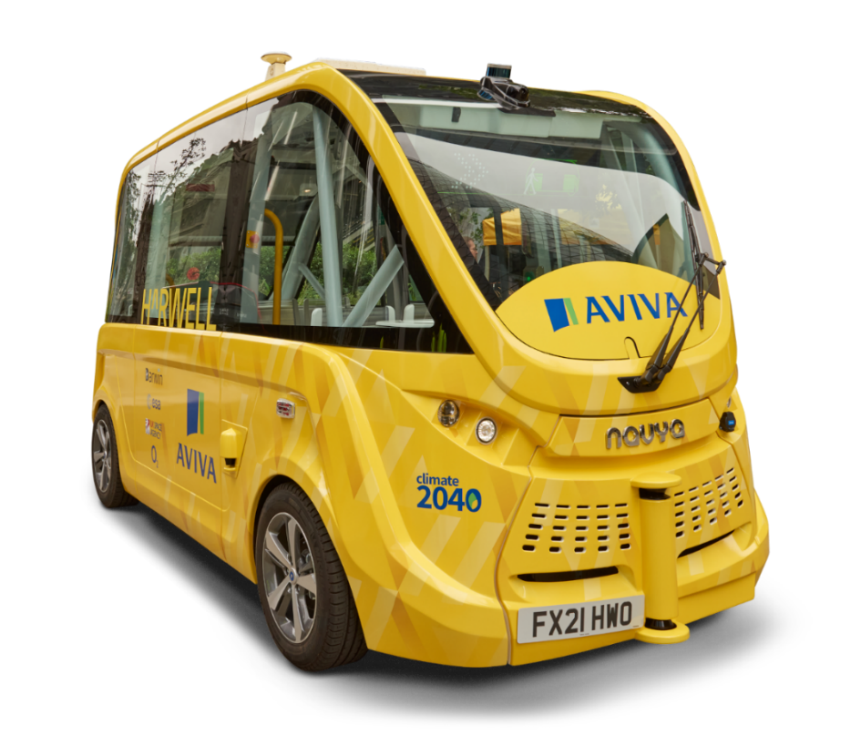






Darwin Connected Autonomous Shuttle
Fully autonomous passenger shuttle, utilising integrated satellite and 5G communications for seamless operation
The Darwin Autonomous Shuttle is a minibus-sized level 4 autonomous vehicle, powered by electricity.
Darwin technology switches seamlessly between terrestrial and satellite networks, showing the ability to remotely control CAVs in urban and rural areas, as well as uses LiDAR sensors, cameras, odometry sensors and a GNSS antenna to position itself and monitor its environment.
Customer Groups: Insurance Companies, Ports,
Darwin Project Link
Achievements
Achievements
Darwin Autonomous Shuttle service is operating at Harwell Science and Innovation Campus, providing a regular passenger transport service to campus residents
First CAV port operation at the Port of Liverpool has launched in 2025, with deployment in mainland Europe planned in 2026
Partnering with Aviva to develop a comprehensive insurance package for autonomous vehicles
Team:
Pilot test partners:

Slide 3
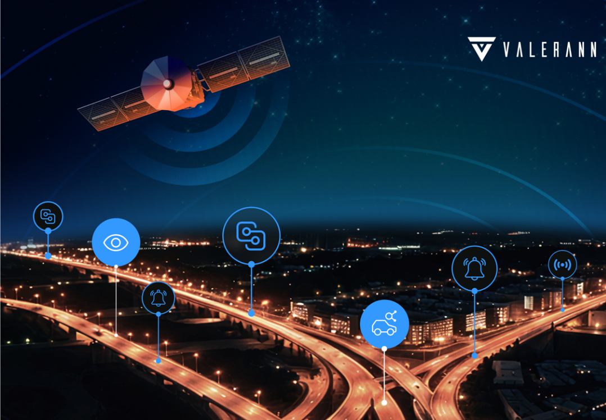

EQUANT ITS & SETSITS
SatCom and SatNav for an AI-powered road traffic monitoring platform
An advanced traffic management platform that integrates diverse data streams—including connected vehicles, roadside sensors, and satellite-enabled weather services—to provide real-time traffic flow information and actionable insights.
Customer Groups: Road Network Control Centre Operators
SETSISTS Project Link
Achievements
Double percentage reduction in serious traffic accidents
Valerann raised $25M in funding
More than doubled their staff in the UK and secured customers across Europe, South and Central America and the US
Team:
Pilot test partners: Brisa (Portugal), National Highways (UK), NYDOT (USA)

